Slide 1
APUSH Review: Dred Scott v. Sanford
Everything You Need to Know About Dred Scott v. Sanford To Succeed In APUSH

Slide 2
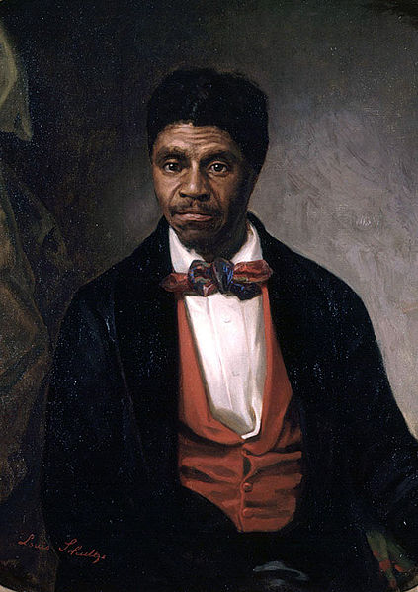
Background: Who was Dred Scott?
Dred Scott, his wife, and two daughters were slaves of a US military Doctor
Prior to Dr. Emerson’s death, Scott traveled with him in different areas of the country, including:
Illinois (a free state)
Wisconsin (a free territory)
After Emerson’s death, Scott sued for freedom on his and his family’s behalf
The Supreme Court hoped to address the issue of slavery once and for all

Slide 3
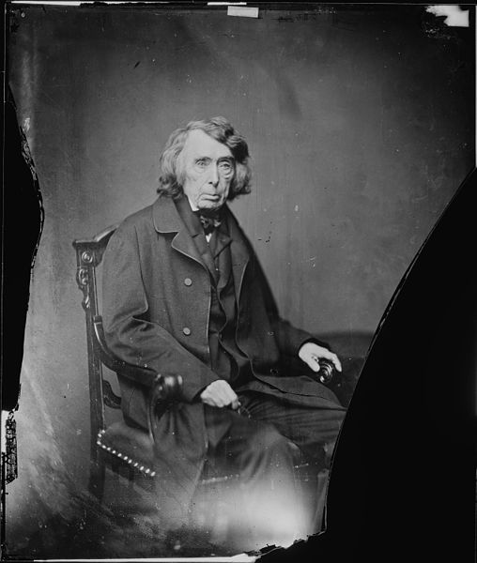
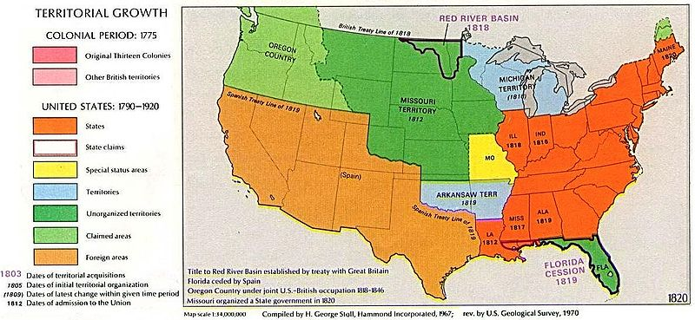
The Supreme Court’s Decision
Chief Justice Roger B. Taney, wrote the majority opinion and stated the following:
African Americans (regardless if they were free or slave) were NOT citizens and could not sue in court
Slaves were considered property and could not be taken away without “due process” (5th amendment)
The Missouri Compromise was unconstitutional; Congress could not regulate slavery in territories

Slide 4
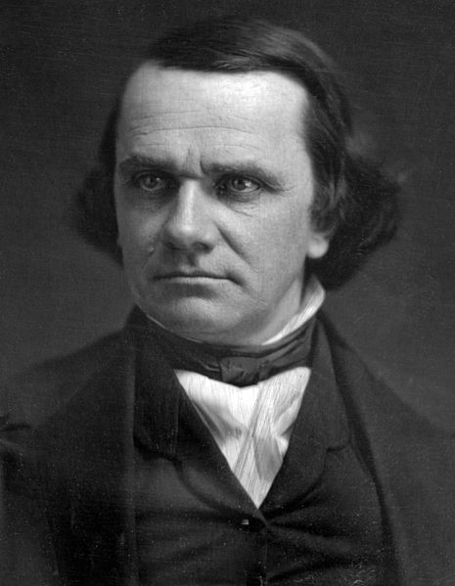
Impact of the Ruling
Tensions increase between North and South
Stephen Douglas, in his famous “Freeport Doctrine” believed territories could not enforce the decision
Splits the Democratic Party along sectional lines
In order for African Americans to become citizens, a new court case, or amendment would be needed
14th amendment (granted citizenship)

Slide 5
Thanks for watching!
Subscribe to my channel
Help spread the word
Questions? Comments? Ideas for videos?
Leave in comments
Download the PowerPoint for this video from the link to APUSHreview.com in the description.
Subscribe
Down here!

